Slide 1
Employee Data Analysis using Excel
STUDENT NAME :
REGISTER NO :
DEPARTMENT :
COLLEGE :
SHREE JYOTHI.C
312211064
BACHELOR OF COMMERCE (GENERAL)
DR. MGR JANAKI COLLEGE OF ARTS AND SCIENCE FOR WOMEN

Slide 2
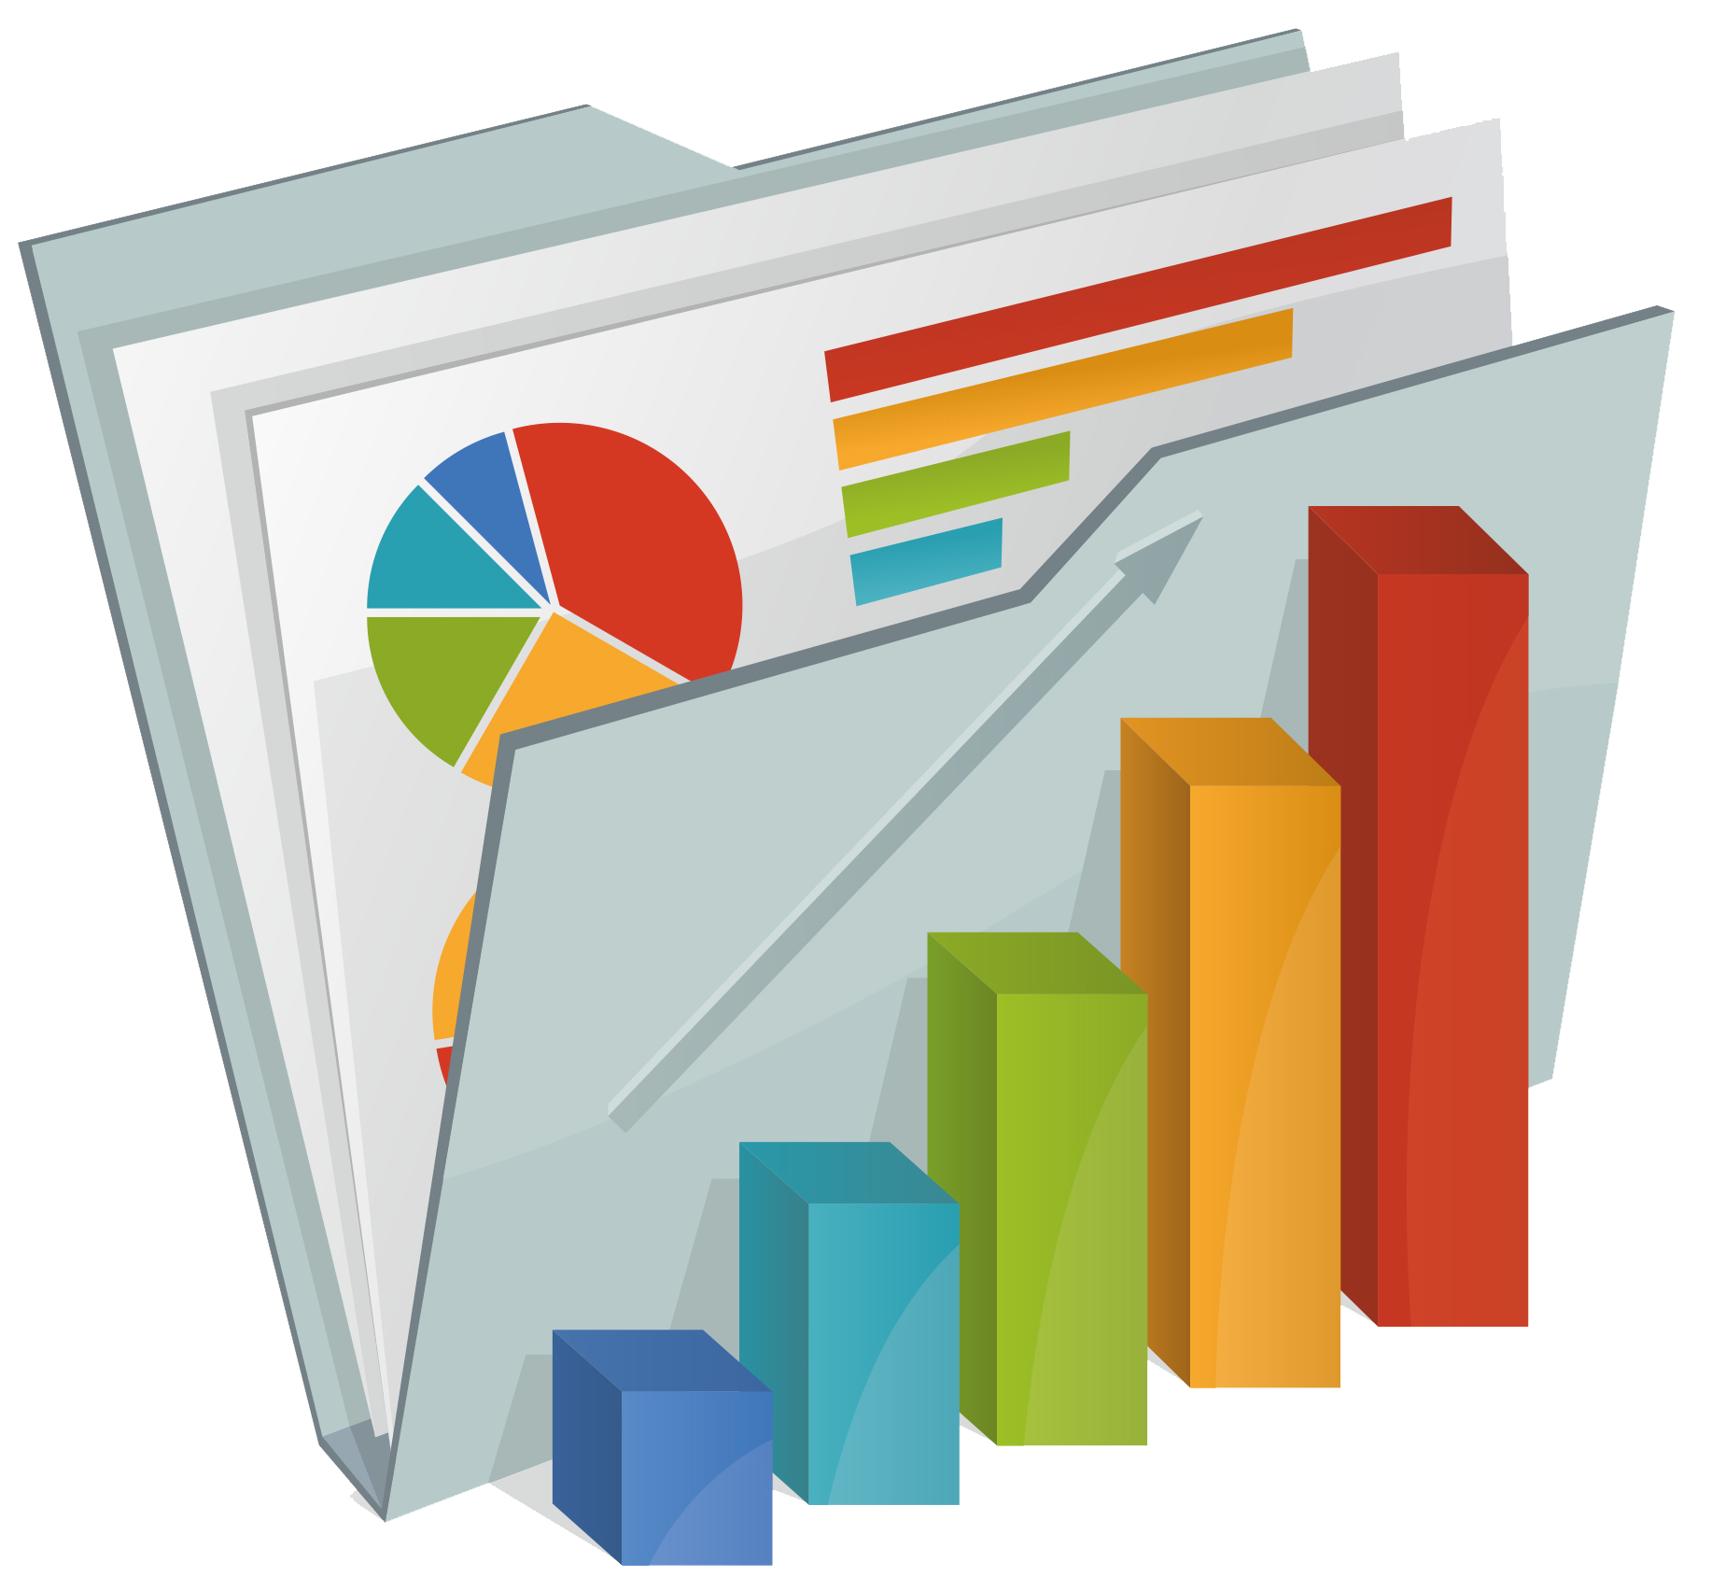
PROJECT TITLE
Employee Performance Analysis using Excel

Slide 3


AGENDA
Problem Statement
Project Overview
End Users
Our Solution and Proposition
Dataset Description
Modelling Approach
Results and Discussion
Conclusion
3/21/2024 Annual Review

Slide 4

PROBLEM STATEMENT
The Aim of doing Employee performance analysis is :
To streamline employee performance tracking and analysis, increasing accuracy and efficiency.
To gain actionable insights into employee strengths, weaknesses, and development needs.
To inform data-driven decisions, driving employee growth and organizational success.

Slide 5

PROJECT OVERVIEW
This project aims to analyze employee performance to improve workforce management and decision-making processes. The analysis focuses on key performance indicators (KPIs) such as productivity, sales targets, project completion rates, attendance, and customer feedback.
Data will be gathered from various internal systems and inputted into Excel for thorough examination. By leveraging Excel's powerful features, such as pivot tables, charts, and conditional formatting, the data will be organized to identify patterns, trends, and outliers.
Statistical functions and formulas will be used to calculate metrics like average performance scores, growth rates, and variance.
The project seeks to uncover areas of high performance, identify employees who may need additional support or training, and provide actionable insights for management.

Slide 6

WHO ARE THE END USERS?
The End Users Of An Employee Analysis System Are :
1. HR Professionals
2. Managers
3. Team Leaders
4. Employees
5. Senior Leadership
6. Talent Development Specialists
7. Compensation and Benefits Analysts

Slide 7

OUR SOLUTION AND ITS VALUE PROPOSITION
The method used on finding performance analysis is:
Conditional Formatting - To Highlight the Blanks cells and change the color of the cell .
Sort & Filter - Remove the Blank Missing Values.
Pivot Table - To aggregate and summarize large data cells into meaning full categories.
Formula –To get the Performance level. IFS(L2>=5,”VERYHIGH”,L2>=4,”HIGH”,L2>=3,"MED",TRUE,”LOW”)
Graphs - To visually represent performance metrics and trends of employees.
Final report on Employees performance .

Slide 8
DATASET DESCRIPTION
Employees Dataset - Kaggle
Total features - 26
Selected features - 9 features
Employee id
Business unit
Gender - male, female
Job function description - job function of the employees
First name – first name of the employees
Current employee rating – The current rating of the employees
Performance level – the level indicating employee performance as very high, high, low

Slide 9

THE "WOW" IN OUR SOLUTION
A New strategy which was used to calculate employee performance level is
Formula used:
=IFS(I2>=5,”VERY HIGH”,I2>=4,”HIGH”,I2>=3,”MED”,TRUE,”LOW”)
This specifies the data into – “very high”, “high”, “low”
3/21/2024 Annual Review
9

Slide 10
MODELLING
DATA COLLECTION: Kaggle was the source used to collect data. total 26 features and selected 9 features to analyze employee performance
DATA CLEANING: the collected data were sorted and filtered using conditional formatting.
TECHNIQUES USED:
Conditional formatting – using this blank cells can be highlighted
Filter and sorting- the blank cells are removed using filter
Pivot table- the pivot table was calculated using the dataset. It had been segregated as follows:-
Filter – gender code
Row labels – job function description
Column – performance level
Values – count of first name
CHART : the graph chart and pie chart is created for the above pivot table.
RESULTS: final report is created using excel on employee performance
10

Slide 11
RESULTS
Trendline graph of employee performance level
Pie chart of employee performance level
11

Slide 12
CONCLUSION
By concluding that, The employee performance analysis conducted using Excel has provided critical insights into productivity and areas for improvement. By utilizing Excel’s data analysis tools, such as pivot tables, charts and conditional formatting, we were able to identify patterns, trends, and able to identify top performers, job functions where employees work highly, and trends in productivity that impact the overall efficiency of the organization.
These findings will inform next steps, which include implementing targeted training programs, recognizing high achievers, and optimizing workflows to enhance overall performance. By continually refining our approach based on the data and insights gained, we can foster a more productive and motivated workforce, driving the organization toward its strategic objectives.

